Slide 1

Detection of multiple skin disorders
Capstone Project Phase A
Supervisor: (Dr.) Zakharia Frenkel
Team members: Oudai Salameh Or Mizrachi
1

Slide 2
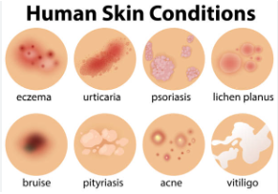
Motivation For The Project
Skin disorders affect as many as one in three Americans at any given time
Skin has high potential to get infected by various infections
help users to get an early indication of various skin diseases
2

Slide 3
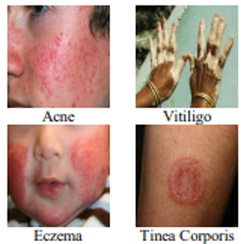

Background and related work - Research
Reviewed multiple researches that classify skin diseases using:
CNN, transfer learning, Google Inception V3
SVM for classifying melanoma skin cancer

Slide 4



Background and related work - Similar programs
The Easy-to-use apps helps offers suggested conditions to the disorder’s image uploaded
Gives automatic 24/7 service.
Provides dermatologist reviewed information.
Ask questions like age, sex, location, race and skin types.
Skin Check: Dermatology App
Aysa Application
AI Dermatologist skin scanner

Slide 5

Background and related work - Previous fellows
The most previous fellow Lipaz and Mor project was to predict and classify only 7 skin cancer types
Using ResNet50 and DenseNet121
The first previous fellows Or and Niv project was to get better prediction and accuracy of the same 7 skin cancer diseases Lipaz and Mor had.
Using ResNetV2 and DenseNet121

Slide 6
The problem we want to solve
Predicting all types of skin diseases and disorders
Handling low-resolution and quality images that are taken by mobile devices
Identifying diseases with different lightning conditions and different skin colors
3

Slide 7
Our Solution
Develop a system to detect all types of skin diseases and disorders.
We use the CNN architecture based on Inception ResNetV2 and DenseNet121.
Use edge detection and cropping methods, and transfer the images through color filters, to enhance their features and resolution.
We expand and continue the previous fellows project which they as said earlier detected only skin cancer.
Notes:
functionality

Slide 8
Desirable functionality
The system that will have the ability to classify all types of diseases :
It will ask the user to upload\take an image, and background information (Age, Sex, Disease Area..)
It will display a list of the closest diseases with a description for each one
The list will be sorted by accuracies (high to low)
It will save the user’s feedback

Slide 9
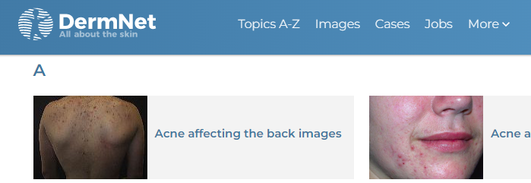
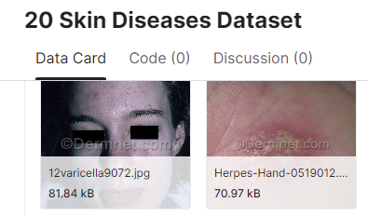
Datasets
Collected massive skin disorders and diseases images from DermNet
Kaggle’s skin disorder dataset

Slide 10
Challenges
Understanding complicated medical papers that talk about skin diseases
Collecting all the images for our large databases,
Researching the best and most suitable architecture for our project

Slide 11
Classification of skin diseases
We want to classify over 250 types of disorders and diseases
Using Categorical cross entropy loss for the CNN score for each class
Applying softmax function to each score to be in range [0,1]

Slide 12
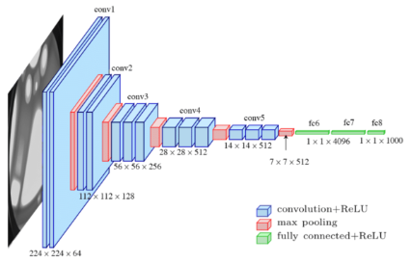
Convolutional neural network
Solves complicated classification for large database.
Analyzing visual imagery: image classification, medical image analysis, etc..

Slide 13
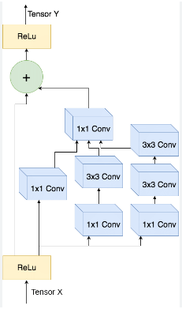
Inception ResNetV2
Version of the ResNet CNN :
Good performance
Robust features
Ease of training
Widely used
Uses skip connections that allows the network to learn
more complex function and improve it’s performance
Notes:
Good performance: they are known to be effective at classifying images, and may be able to achieve good performance on skin disease detection tasks.
Robust features: they are able to learn robust features from images, which can be useful for detecting subtle differences between different skin diseases.
Ease of training: they are relatively easy to train, which can make it faster and easier to develop a skin disease detection system using these models.
Widely used: they are both widely used in the field of computer vision, and there is a wealth of resources and knowledge available for using these models.

Slide 14
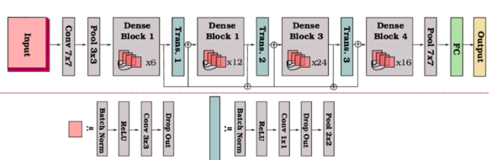
DenseNet121
Version of DenseNet
Faster to train and easier to use
Base model for image classification tasks

Slide 15
Soft attention
Increases the prediction rates and focusing on relevant features of the image
Ignoring other features that are less relevant
Giving high weight close to 1 with relevant features and low weights close to 0 to less relevant ones

Slide 16
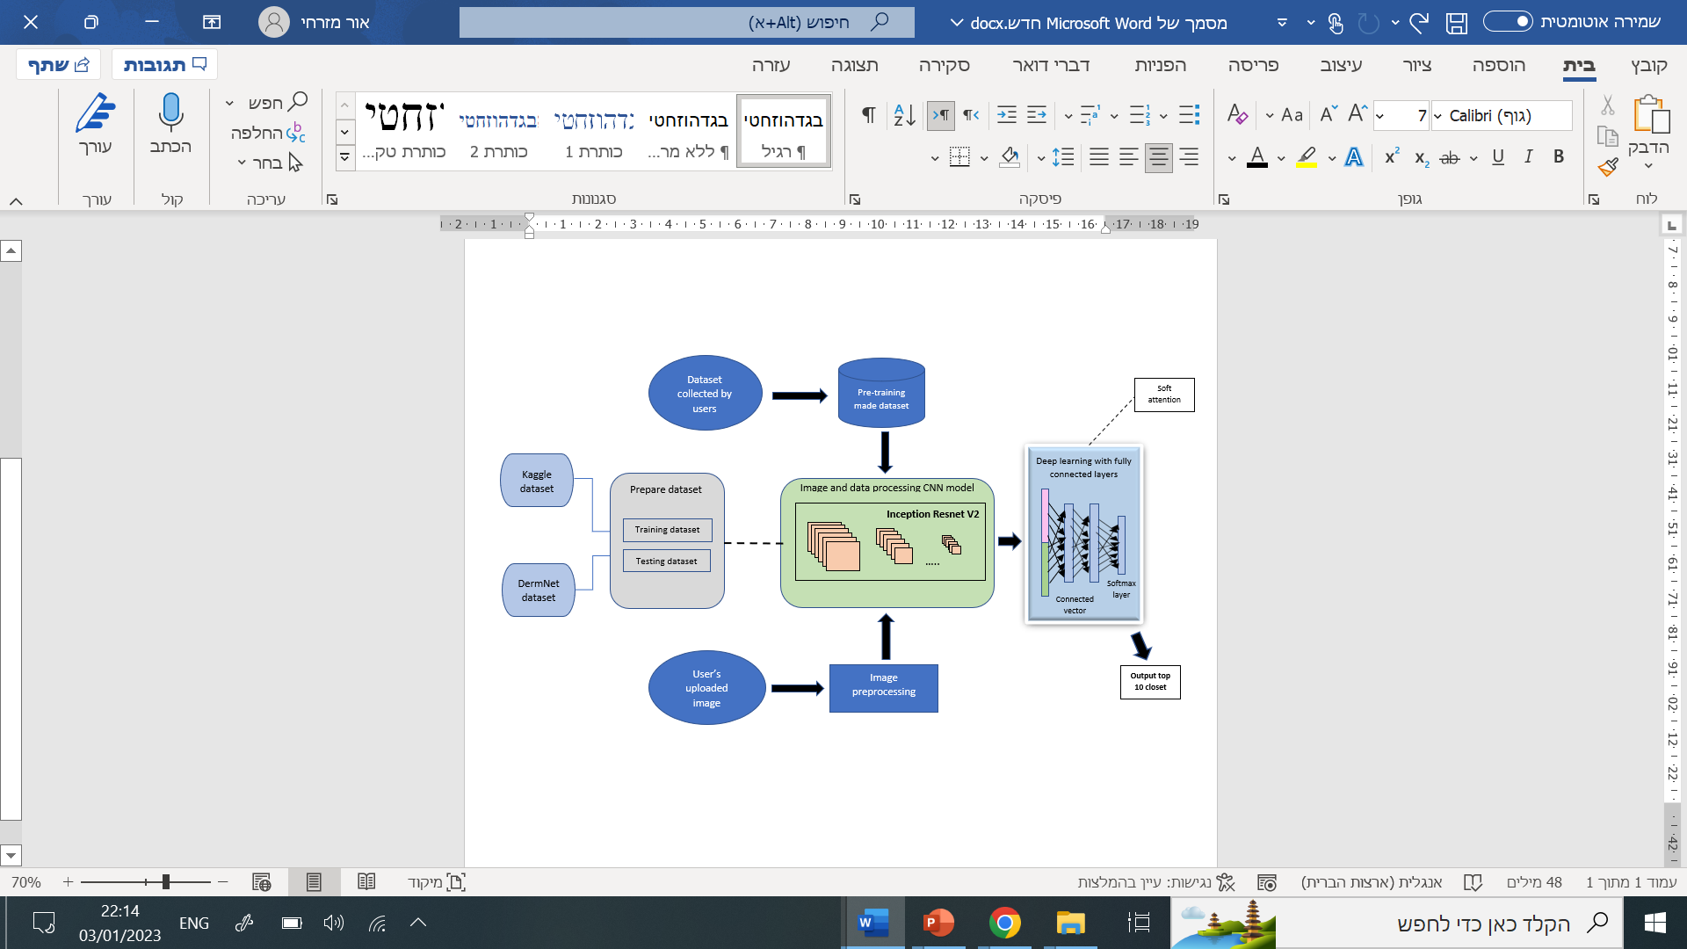
The network

Slide 17
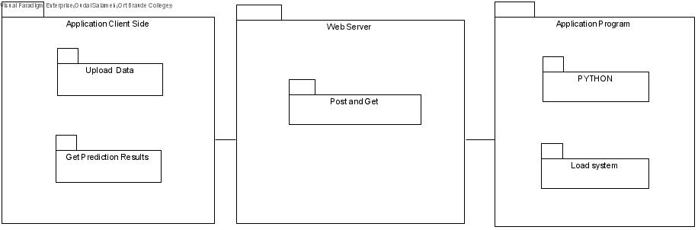
Deployment Diagram

Slide 18
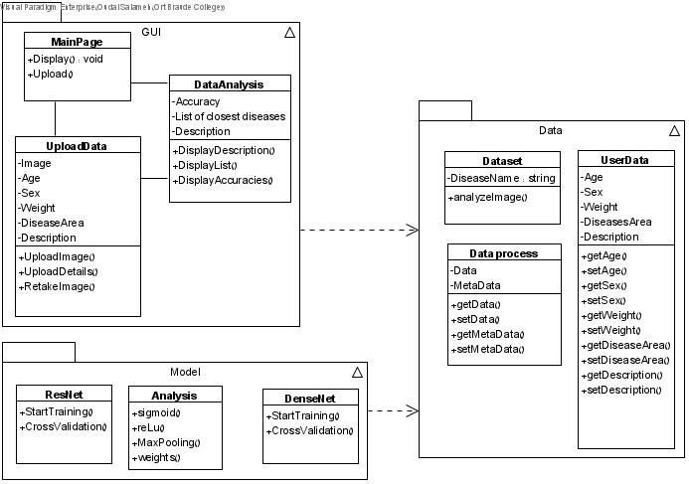
Class diagram

Slide 19
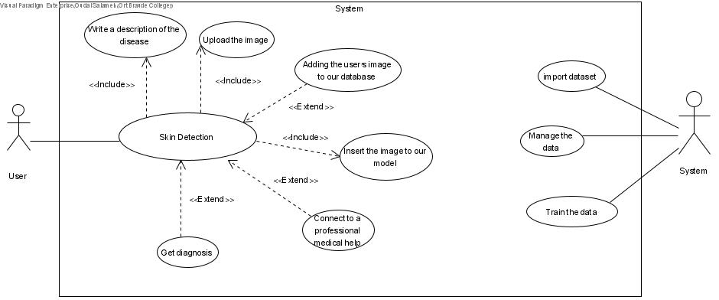
Use Case Diagram

Slide 20
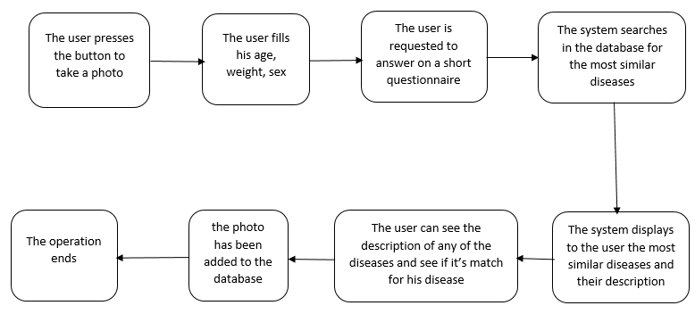
Simple User Flow-chart

Slide 21
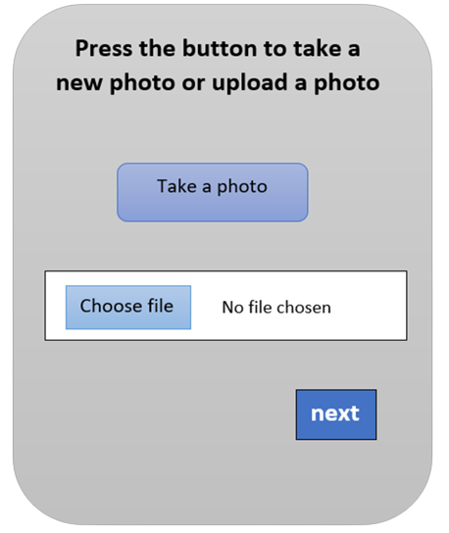
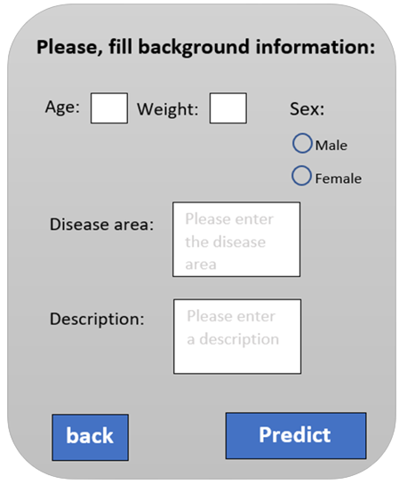
GUI

Slide 22
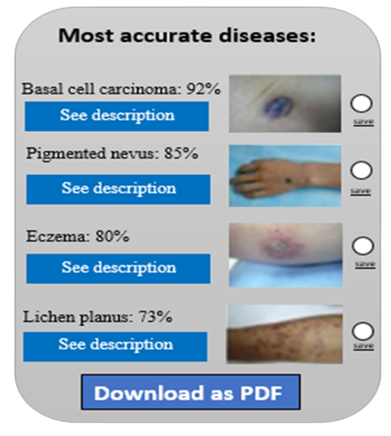
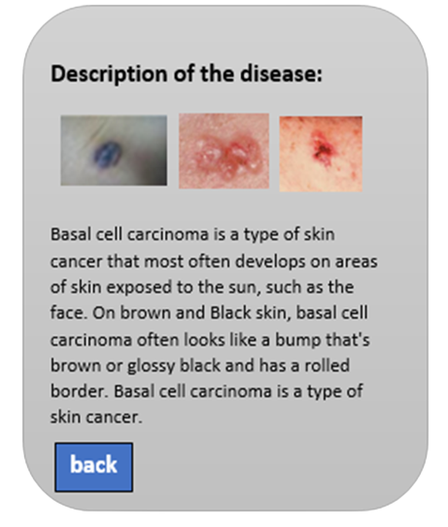

GUI

Slide 23
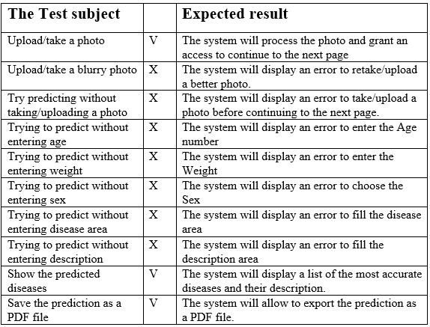
Verification plan

Slide 24
Thanks for listening !

